Slide 1
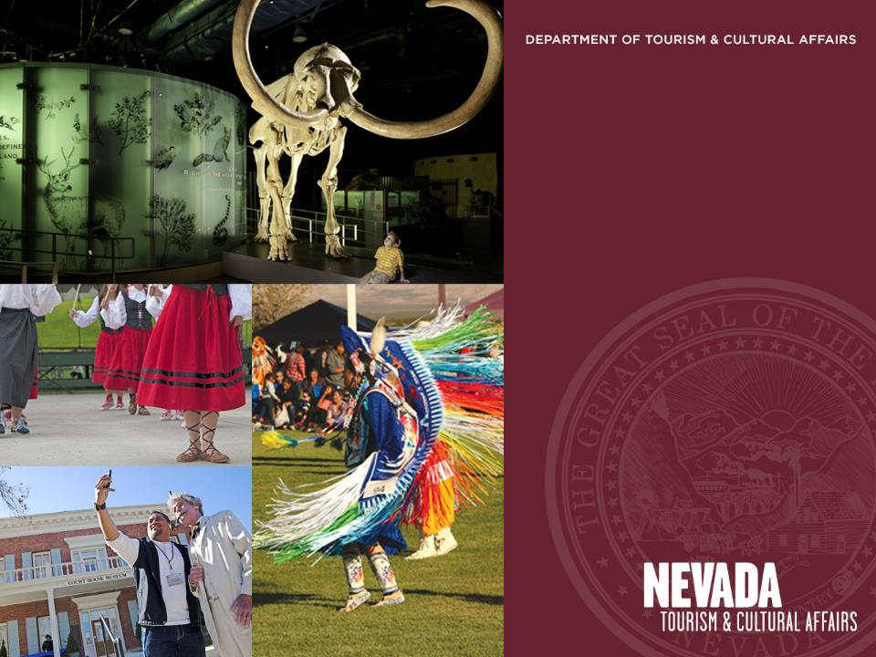
Division of Museums and History
Nevada Indian Commission
Capital Improvement Program
Public Works Board
August 26, 2020

Slide 2

Nevada Department of Tourism and Cultural Affairs
Projects

Slide 3
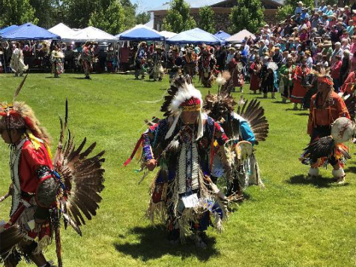
Nevada Indian Commission
The mission of the Nevada Indian Commission is to ensure the well-being of American Indian and Alaska Native citizens statewide through development and enhancement of the government-to-government relationship between the State of Nevada and Indian Tribes and through education for a greater cultural understanding of the State’s first citizens.

Slide 4
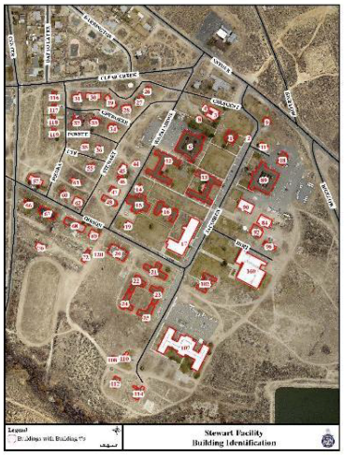
Stewart Living Legacy
The Stewart Indian School changed the course of generations of American Indians. For more than 90 years, American Indian children were removed from their homelands, family, and culture with profound impacts on their lives. The Stewart Indian School Living Legacy preserves their stories and cultural legacy: Never to be Forgotten.

Slide 5
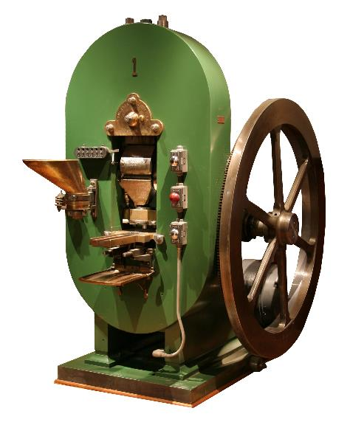
Division of Museums and History
Mission
The Division of Museums and History preserves, shares and promotes the understanding and celebration of Nevada’s natural and cultural heritage for the enrichment of all generations.
Vision
Recognized as the most trusted stewards and engaging storytellers of Nevada’s heritage.
Philosophy
We will work as a team to build consensus and fulfill our vision, putting the public’s needs first while adhering to the highest professional standards.

Slide 6
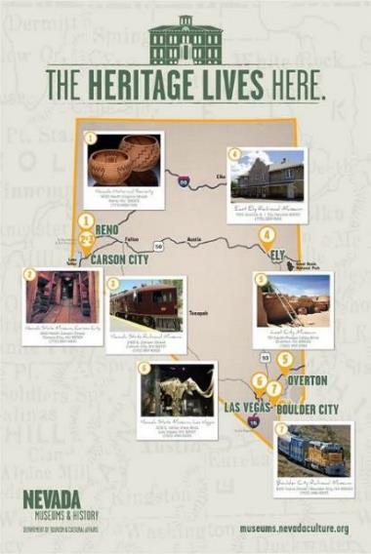
Snapshot
7 Museums
39 Buildings and structures
$108 million estimated replacement value
$10+ million estimated repair costs over next 10 years.
Approximately $2.8 million in immediate critical maintenance needs.

Slide 7
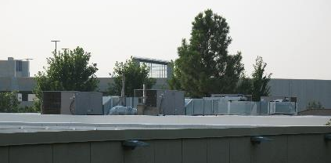
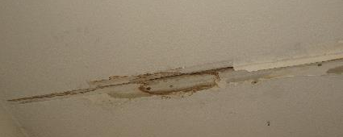
division of museums and history
Nevada Historical Society
HVAC System Renovation Type: Renovation
SPWD #7460 SPWD estimate: $584,098
DTCA Rank: #1
Overview
This project will replace five rooftop packaged gas-electric HVAC units and the associated exposed ductwork on the roof of the Nevada Historical Society Building in Reno.
These heating and cooling units serve the collection storage portion of the building.
Justification
The existing rooftop units are more than 20 years old and have reached the end of their useful service life.
They also utilize R-22 refrigerant which can no longer be manufactured or imported into the United States starting January 1, 2020.
The ductwork that is exposed on the roof has begun to leak and is a source of potential water damage inside the building.
A system failure could create an emergency and need to relocate collections.
1

Slide 8
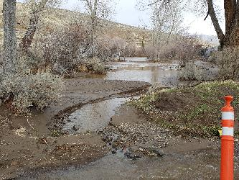
division of museums and history
Nevada State Railroad Museum Carson City
Drainage and Fire Access road improvements Type: Renovation
SPWD #19171 SPWD estimate: $1,557,332
DTCA Rank: #2
Overview
- This project will design and construct improvements to the site drainage system and repair of the railroad track turntable and tie the drainage into the Carson City storm system.
(A 2020 project restored flow on the property but did not address long-term flooding concerns.)
- The project’s drainage construction scope includes widening and riprap lining of the large drainage channel on the south perimeter, deepening of the pond, upgrade of culverts and smaller drainage ditches, repair and slurry seal of the fire access road, and regrading of open space north of the museum.
– An overall site drainage study is included to help coordinate the site’s drainage needs with the ongoing Carson City regional drainage needs.
Justification
- A January 2017 flood event overwhelmed the site drainage system and caused significant damage to drainage channels, railroad tracks, turntable, fire access road, Interpretative Center and Shop Annex.
- Carson City has constructed a sewer tie-in to accept the run-off. Connection to this system will mitigate future flooding issues.
- The drainage study and implementation of the recommendations are critical to mitigate on- and off-site storm flows on the museum property.
2

Slide 9
division of museums and history
Nevada State Museum Las Vegas
Plumbing Upgrade Type: Renovation
SPWD #19050 SPWD estimate: $147,083
DTCA Rank: #3
Overview
Replace existing hot water tanks and modify existing domestic water plumbing in the kitchen.
Justification
Water heater replacement recommended in Facility Condition Analysis, however existing design is highly inefficient and costly to maintain requiring modifications.
3

Slide 10
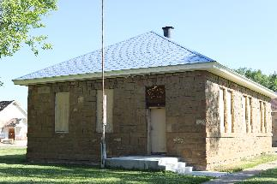
division of museums and history
Stewart facility
Collections Storage Building (Building #19) Type: Renovation
SPWD #19275 SPWD estimate: $1,305,378
DTCA Rank: #4
Overview
This project designs and renovates Building #19 at Stewart Indian School, the former Bakery and Post Office, built in 1926 with 1,646 square feet available in an open floor plan.
The renovation work includes complete interior renovation, environmental controls, and installation of high-density mobile shelving to provide professional best practices storage of the historical Stewart artifact collections.
Justification
- In 2001, items from the Stewart Indian School were donated to the Bureau of Indian Affairs (BIA). The items belonged to a museum located at Stewart from 1982-2001.The Nevada State Museum (NSM) agreed to temporarily store the 1,900 artifacts, and 5,000 photographs, and documents, at the Indian Hills Curatorial Center on Topsy Lane in Carson City. Today, the Curatorial Center is overcrowded and the NSM is seeking funding to renovate this building.
- The Stewart Indian School Cultural Center & Museum staff is in negotiations with the BIA to become the permanent repository for the collection. In order for the BIA to approve this repository status, the staff have to provide environmentally controlled storage space for those collections on the Stewart campus. Relocating these items will also allow the Curator to preserve the items in archivally safe enclosures and exhibit them in the Stewart Indian School Cultural Center & Museum.
- Unfortunately, because of COVID-19 related state budget cuts, this project was moved to the 2021 Nevada Legislative session for approval.
5

Slide 11
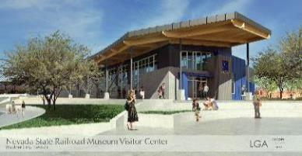
division of museums and history
Nevada State Railroad Museum Boulder City
Advanced planning: Visitors’ Center Type: Design
SPWD #7247a SPWD estimate: $1,704,833
DTCA Rank: #5
Overview
This project will complete the design through construction documents for a 9,700 s.f. visitor center and auxiliary facilities located at the southeaster end of the railroad museum site, adjacent to the site of the original Boulder City Railroad depot, and at the entrance to downtown Boulder City.
The initial structure has been designed through schematic review, using a $471,000 grant from Tourism. Also, a site plan has been completed using museum trust funds ($13,000) and a donation from the museum’s support group ($10,000). Construction funds ($25 million) for this project were included in AB-84. The City of Boulder City has received RTC funds (5.5 million) to install the access road through the museum site. That project is scheduled to begin this fall.
4a

Slide 12
division of museums and history
Nevada State Railroad Museum Boulder City (Slide 2)
Advanced planning: Visitors’ Center Type: Design
SPWD #7247a SPWD estimate: $1,704,833
DTCA Rank: #5
Justification
This museum has seen significant increases in visitation (53,000 visitors in 2019). With the completion of the I-11 freeway project, the railroad line severed decades ago has been restored, enabling longer train rides into Henderson and potentially Las Vegas creating even higher demand. The current visitor facilities which have less than 300 square feet of air-conditioned space cannot adequately and comfortably accommodate this growing demand.
In addition to an expanded depot capable of serving customers, a railroad boarding platform and tracks will be added. Additional improvements to the property, including elements of a public park and an extension to the adjacent bikeway are planned. The first phase of that new bike path funded with trails and county grants totaling $160,000 is currently underway.
4a

Slide 13
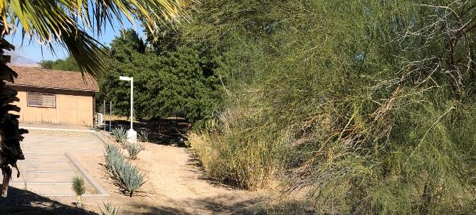
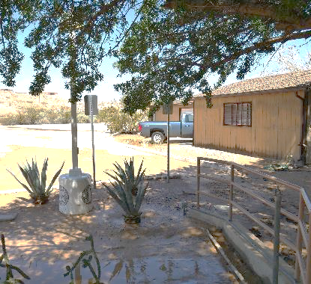
division of museums and history
Lost City Museum
Reconstruct Parking and Drainage Type: Renovation
SPWD #21203 SPWD estimate: $970,285
DTCA Rank: #6
Overview
Design through construction to reconstruct parking area that accommodates the loss of drainage due to recent infill of the onsite irrigation ditch.
Subject to annual rain events, the parking lot becomes unusable and water runoff damages outbuildings that contain artifacts and equipment.
Justification
6

Slide 14
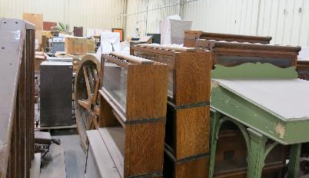
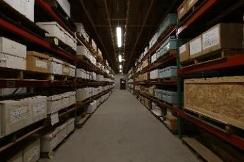
division of museums and history
Indian Hills Curatorial Center
Curatorial Center Expansion Type: New construction
SPWD #19178 SPWD estimate: $18,614,834
DTCA Rank: #7
Overview
This project will complete the design and construct a 27,700 sf Curatorial Center on Topsy Lane.
This project is the first of multiple phases to construct the offices, workrooms, receiving areas and needed collections' storage.
The project includes appropriate HVAC systems to control climate, a receiving area to manage and treat incoming materials, specialized curatorial work areas to examine, process and prepare incoming artifacts and expand collection storage space.
The center also provides space to numerous federal customers.
Justification
The existing Indian Hills Curatorial Center (15,400 sf) is at full capacity, putting future collecting at risk.
In addition, storage conditions at the current center are substandard and are potentially harmful to existing collections.
Other storage areas maintained by the Nevada State Museum for state collections are also at full capacity, putting collections at risk and jeopardizing future accreditation.
7

Slide 15
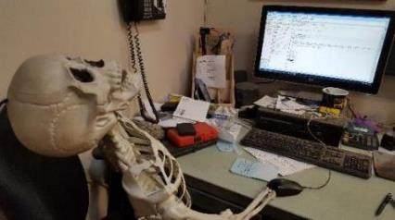
division of museums and history
Nevada State Railroad Museum Carson City
Install Fiber Optic Infrastructure Type: Renovation
SPWD #19167 SPWD estimate: $373,186
DTCA Rank: #8
Overview
This project will provide for modern fiber optic infrastructure for data and communications within the Nevada State Railroad Museum.
Installation will include conduit, vaults, and trenching, which will provide the required pathway for the installation of high-speed internet.
Justification
- The facility currently relies on obsolete dial-up speed communications.
- Current speeds for data communication are well below the industry standards. Upgrades to software are not possible with these connections. - Cloud based systems are increasingly impossible to access.
- A high-speed connection is necessary for efficient research, data transfer, communications and museum exhibits. Medium and large data and image files are still hand carried to other agencies and the public because the Museum cannot export or import these files.
- This infrastructure is needed for AT&T or another vendor to be able to install broadband speed internet.
8

Slide 16
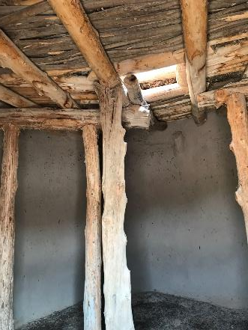
division of museums and history
Lost City Museum
Historic Pit House and Adobe Pueblos Repair Type: Renovation
SPWD #21205 SPWD estimate: $370,808
DTCA Rank: #9
Overview
Assess and repair the historic pit house and adobe pueblos at the Lost City Museum.
Justification
The Civilian Conservation Corps built an adobe pit house and pueblo for exhibition at Lost City Museum in 1935, which is listed on the National Register of Historic Places. Currently closed to the public, these treasures need to be restored for an immersive educational experience in southern Nevada's past.
9

Slide 17
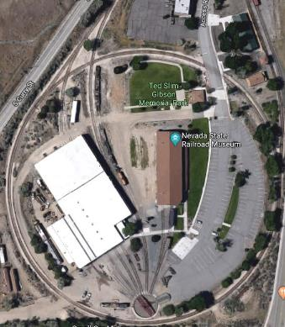
division of museums and history
Nevada State Railroad Museum Carson City
Install security system & exterior lighting Type: Upgrade & installation
SPWD #7067 SPWD estimate: $1,478,427
DTCA Rank: #10
Overview
This project will install a site wide security system, pole lighting, and lighting controls at the Nevada State Railroad Museum, Carson City.
The security system will include the Annex buildings, Restoration Shop, Wabuska Depot, and the Nelson House.
The additional lighting will include perimeter and parking area mounted 30-foot tall light poles with LED fixtures, and lighting controls.
Justification
- The Nevada State Railroad Museum sits on a 13-acre site and houses historical documents and irreplaceable artifacts related to the history of the Nevada railroads.
- Thefts of irreplaceable museum artifacts have occurred in recent years.
- Current lighting systems are controlled by 40-year-old electrical circuit breakers. This system of controls exposes staff to potentially unsafe working conditions.
10

Slide 18
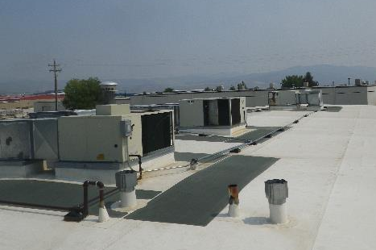
division of museums and history
Marjorie Russell Research Center
Upgrade heating and air conditioning Type: Replacement
SPWD #7390 SPWD estimate: $170,074
DTCA Rank: #11
Overview
This project includes replacement of the existing heating, ventilating, and air conditioning equipment at the Marjorie Russell Clothing and Textile Research Center.
The affected areas of the building are utilized to store historical clothing and textile collections.
Justification
The existing equipment is more than 25 years old and has reached the end of its useful life.
A catastrophic failure could quickly harm historic objects and flags and risk forfeiture of accreditation.
11

Slide 19
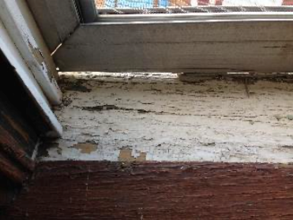
division of museums and history
East Ely Railroad Depot Museum
Energy conservation upgrades Type: Replacement
SPWD #7455 SPWD estimate: $1,521,058
DTCA Rank: #12
Overview
This project will replace failing windows and baseboard electric heaters at the historic 1907 East Ely Railroad Museum
(Passenger Depot Building)
Justification
The windows were last replaced in 1970 and the baseboard heaters were last replaced in 1990.
Each of these components is nearing the end of its useful service life.
Leaks around the existing windows cause drafts, unstable air temperature and the introduction of airborne particles (dust).
The baseboard heaters are inefficient and cannot be easily controlled.
12

Slide 20
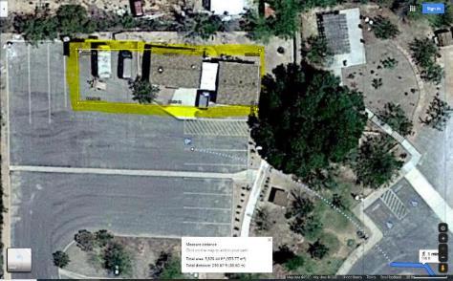
division of museums and history
Lost City Museum
Collections Storage Building Type: Renovation
SPWD #21207 SPWD estimate: $2,183,041
DTCA Rank: #13
Overview
Design and construct a collections storage building at the Lost City Museum campus.
Justification
Lost City Museum has never had a dedicated, temperature and humidity-controlled storage area for its museum artifacts. A new facility would replace two degraded buildings and provide the space needed to remove collections from offices and closet spaces.
13

Slide 21
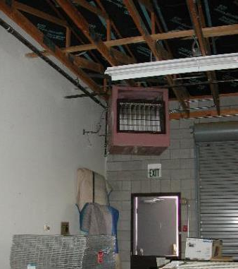
division of museums and history
Indian Hills Curatorial Center
HVAC System Renovation Type: Renovation
SPWD #7391 SPWD estimate: $734,973
DTCA Rank: #14
Overview
This project includes installation of new heating, ventilating, and air conditioning equipment.
The project would also add exterior wall insulation on the outside of the existing masonry walls (since interior insulation is not practical due to extensive anchored shelving that is installed against the walls inside the building) and would replace the existing southeast overhead door.
The affected areas of this building are utilized to store historical and anthropological collections.
Justification
New heating, ventilating, and air conditioning equipment is necessary to provide appropriate temperature conditions for the museum collections stored at this facility (ability to maintain space temperatures at or below 80 degrees in summer and at or above 60 degrees in winter).
The existing equipment (heating and ventilation only) is approximately 30 years old, inefficient, and has reached the end of its useful service life. The southeast overhead door is not insulated and does not seal well.
14

Slide 22
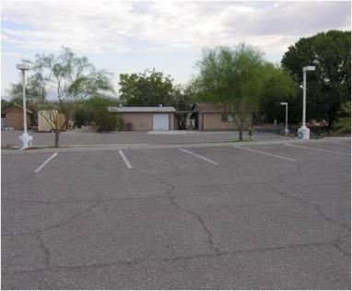
division of museums and history
Lost City Museum
Upgrade exterior lighting Type: Renovation
SPWD #7434 SPWD estimate: $600,237
DTCA Rank: #15
Overview
This project will add pole mounted area lighting to the facility, and upgrade the existing lighting, which will provide energy efficient LED lighting to replace the existing high-pressure sodium light fixtures.
Justification
In addition to the core museum, there are numerous exterior exhibits and shop buildings.
There is very little light available for the parking lot and picnic areas of this facility.
The staff cannot see if there are people present on the property after dark, which results in possible safety and security issues.
Evening events are seriously hampered by the lack of adequate lighting.
The existing lighting is orange and makes it difficult to see anything, especially when the staff is called after hours to investigate security alarm issues.
15

Slide 23
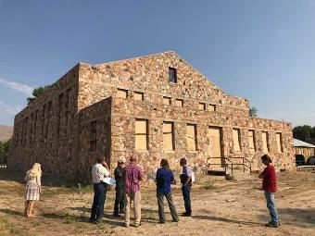
division of museums and history
Stewart facility
Old Gym rehabilitation and seismic stabilization Type: Critical maintenance
SPWD #19270 SPWD estimate: $16,970,789
DTCA Rank: #16
Justification
The Stewart Indian School Master Plan designates Building #20 as a flexible meeting space for conferences, community events, and gatherings. This use provides a potential revenue stream for the sustainability of the Stewart Indian School Living Legacy initiative underway at Stewart Indian School. The Old gym, built in 1938, is the heart of the campus and has been identified by the Stewart Master Plan Team as an integral part of telling the story of the Stewart Indian School athletic program. This project is a continuation of SPWD project number 17-C09, which provided a new roof and seismic stabilization of the roof. This project addresses the seismic deficiencies in the remainder of the building. This project was requested in the 2019 CIP.
Overview
This project will complete the seismic stabilization and rehabilitation of the Old Gym (Building #20) at the Stewart Facility.
16

Slide 24
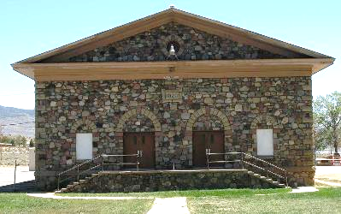
nevada indian commission
Stewart Indian School
Advance Planning — Auditorium Building Rehabilitation Type: Renovation
SPWD #21237 SPWD estimate: $1,602,951
DTCA Rank: #17
Overview
This project will complete the design through construction documents for the Auditorium Building (#90) at the former Stewart Indian School. This project will plan the rehabilitation of the 4,930 square foot auditorium.
Justification
The Auditorium, built in 1925, has been identified in both the Stewart Indian School Landscape Preservation Plan (2007) and the Stewart Master Plan (2018) as a significant building to the history of the Stewart Indian School campus and a priority for rehabilitation. The City of Carson City in their recent strategic planning meeting identified a need for renting such a small performing arts space at Stewart for plays and small performances like poetry readings or musical events.
17

Slide 25
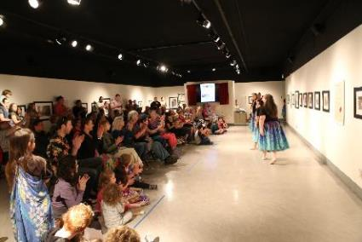
division of museums and history
Nevada State Museum Carson City
Event Hall Addition Type: New Construction
SPWD #19164 SPWD estimate: $2,832,810
DTCA Rank: #18
Overview
Design through construction of a 3,000 sf, 180-seat event hall addition to the Nevada State Museum.
The Event Hall will include a lecture/assembly room, serving kitchen, storage, and modern technology including A/V and lighting systems.
Technology will support lectures with presentation materials, cultural programs that include music and dance, and enough space to move outdoor events inside during inclement weather.
Justification
The museum does not currently have appropriate or adequate space for lectures and events.
The default gallery space used for these types of programs seats a maximum of 85 people. Offered programs quickly reach capacity requiring the museum to limit attendance.
The default space is also not optimal for all events due to its configuration and location inside the museum.
18

Slide 26
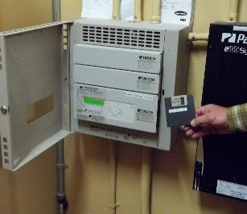
division of museums and history
Nevada State Museum, Las Vegas
Install and upgrade lighting, surveillance
and alarm systems Type: Critical Maintenance
SPWD #7094 SPWD estimate: $213,510
DTCA Rank: #19
Overview
Museum constructed 2007-2009, opened in 2011
Lighting control system is complex and critical to safety and delivery of public program. Lighting controller is obsolete and parts and upgrades no longer available
Lack of building security and intrusion alarm increase risk of loss and threatens reaccreditation
Existing video surveillance system does not adequately meet needs
Justification
Reliable lighting controller necessary to manage the complex nature of building and multiple uses (exhibit galleries, classrooms, storage and maintenance areas)
Intrusion alarm on 20 exterior doors crucial to safe-keeping facility, exhibits and museum collections
With limited security staff, a vibrant and comprehensive video surveillance system, with recording capability is critical
10

